Slide 1

TRUCK TREK EXPERT
We carry trust instead of carriage

Slide 2

01
02
03
BOOKING
DRIVERS
TRUCKS
TABLE OF CONTENTS
04
05
06
CITIES
WHY US
ABOUT
You can book any truck from available cities
You can choose any available driver
You can choose any truck according to ur need
Broad range of indian cities
Trusted since 1999
1 lakh+ customers
Something about our company

Slide 3

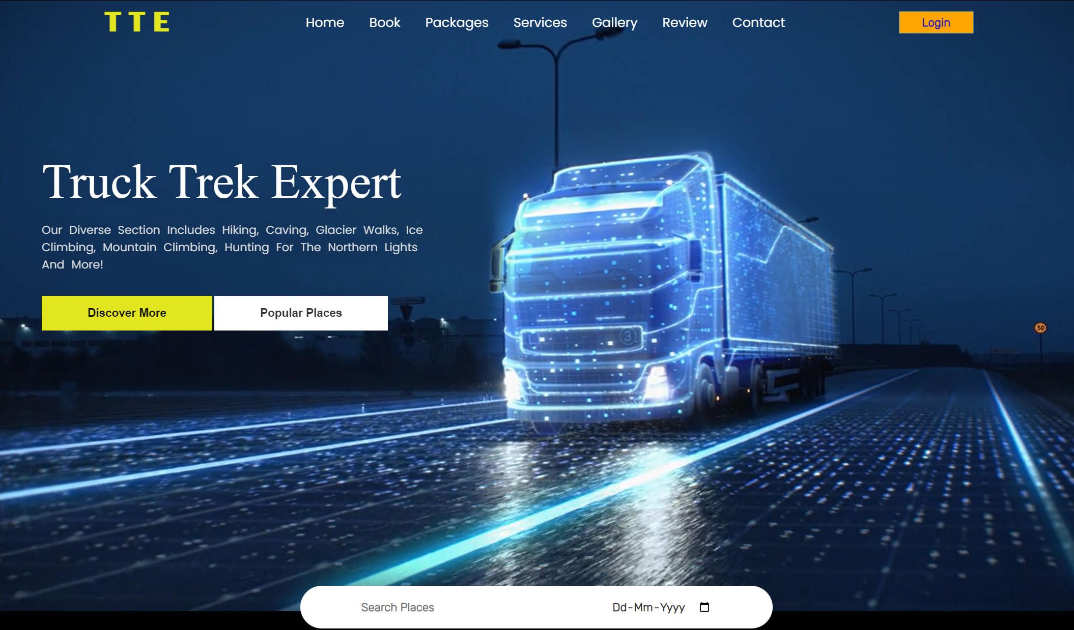
MISSION STATEMENT
We created this website to provide convinience to our customers by providing them best trucks and drivers.

Slide 4
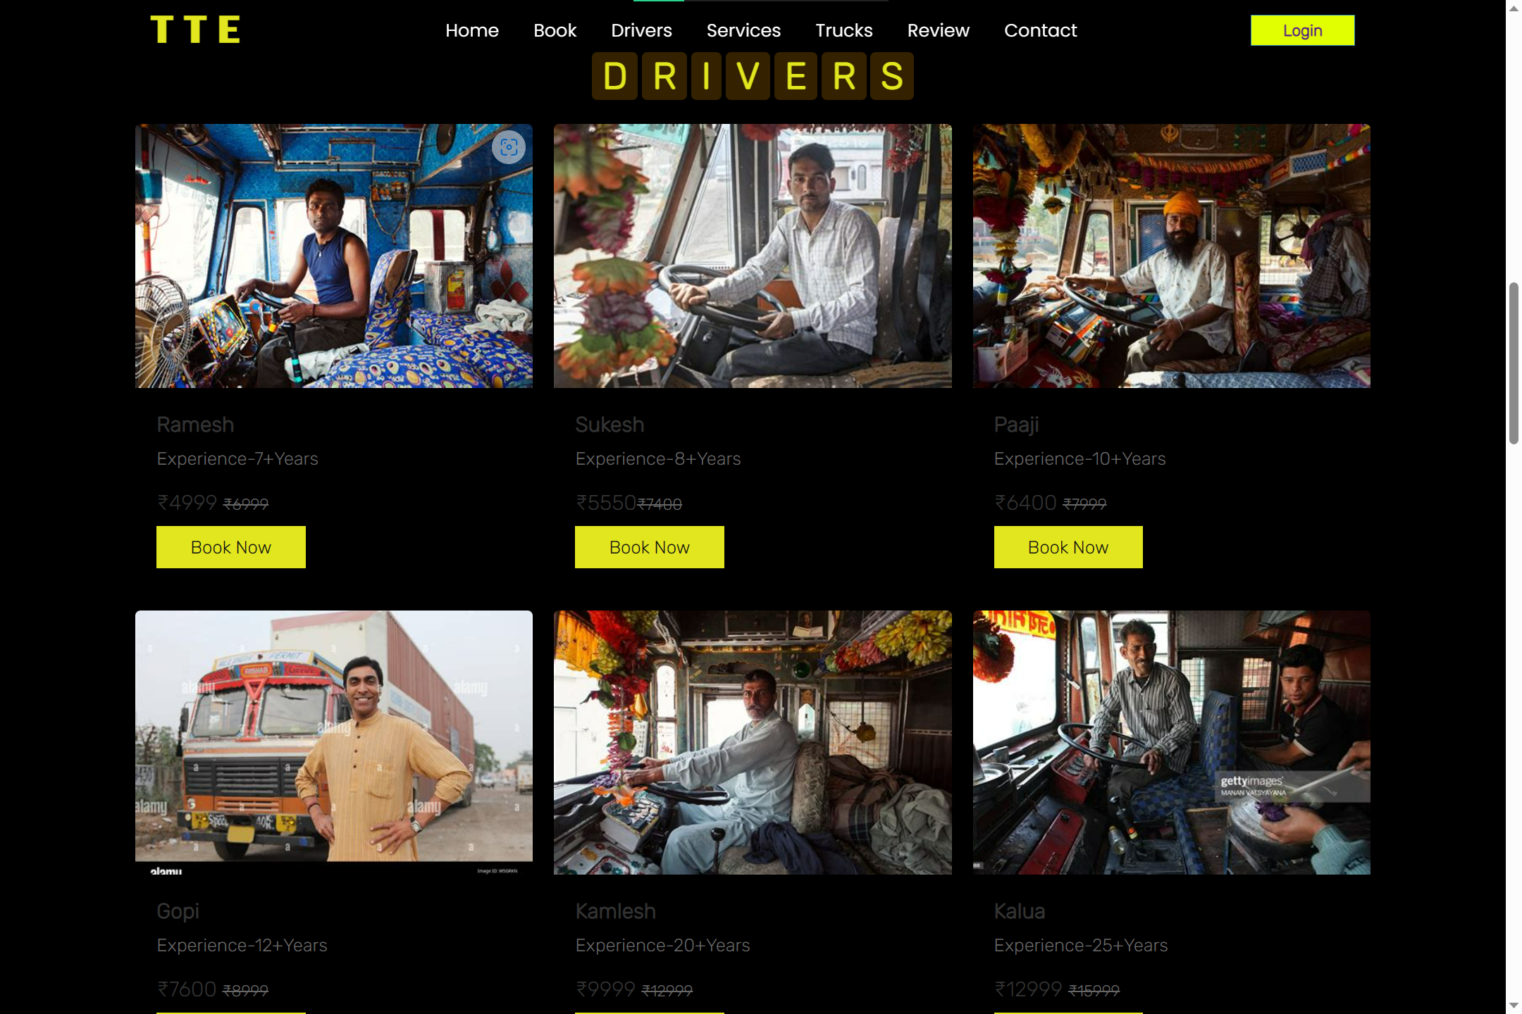
OUR TRUSTED DRIVERS

Slide 5

OUR COMPANY
Trucking logistics is an important part of business operations. This presentation will discuss how trucking logistics can help you optimize costs and increase efficiency in your operations.

Slide 6

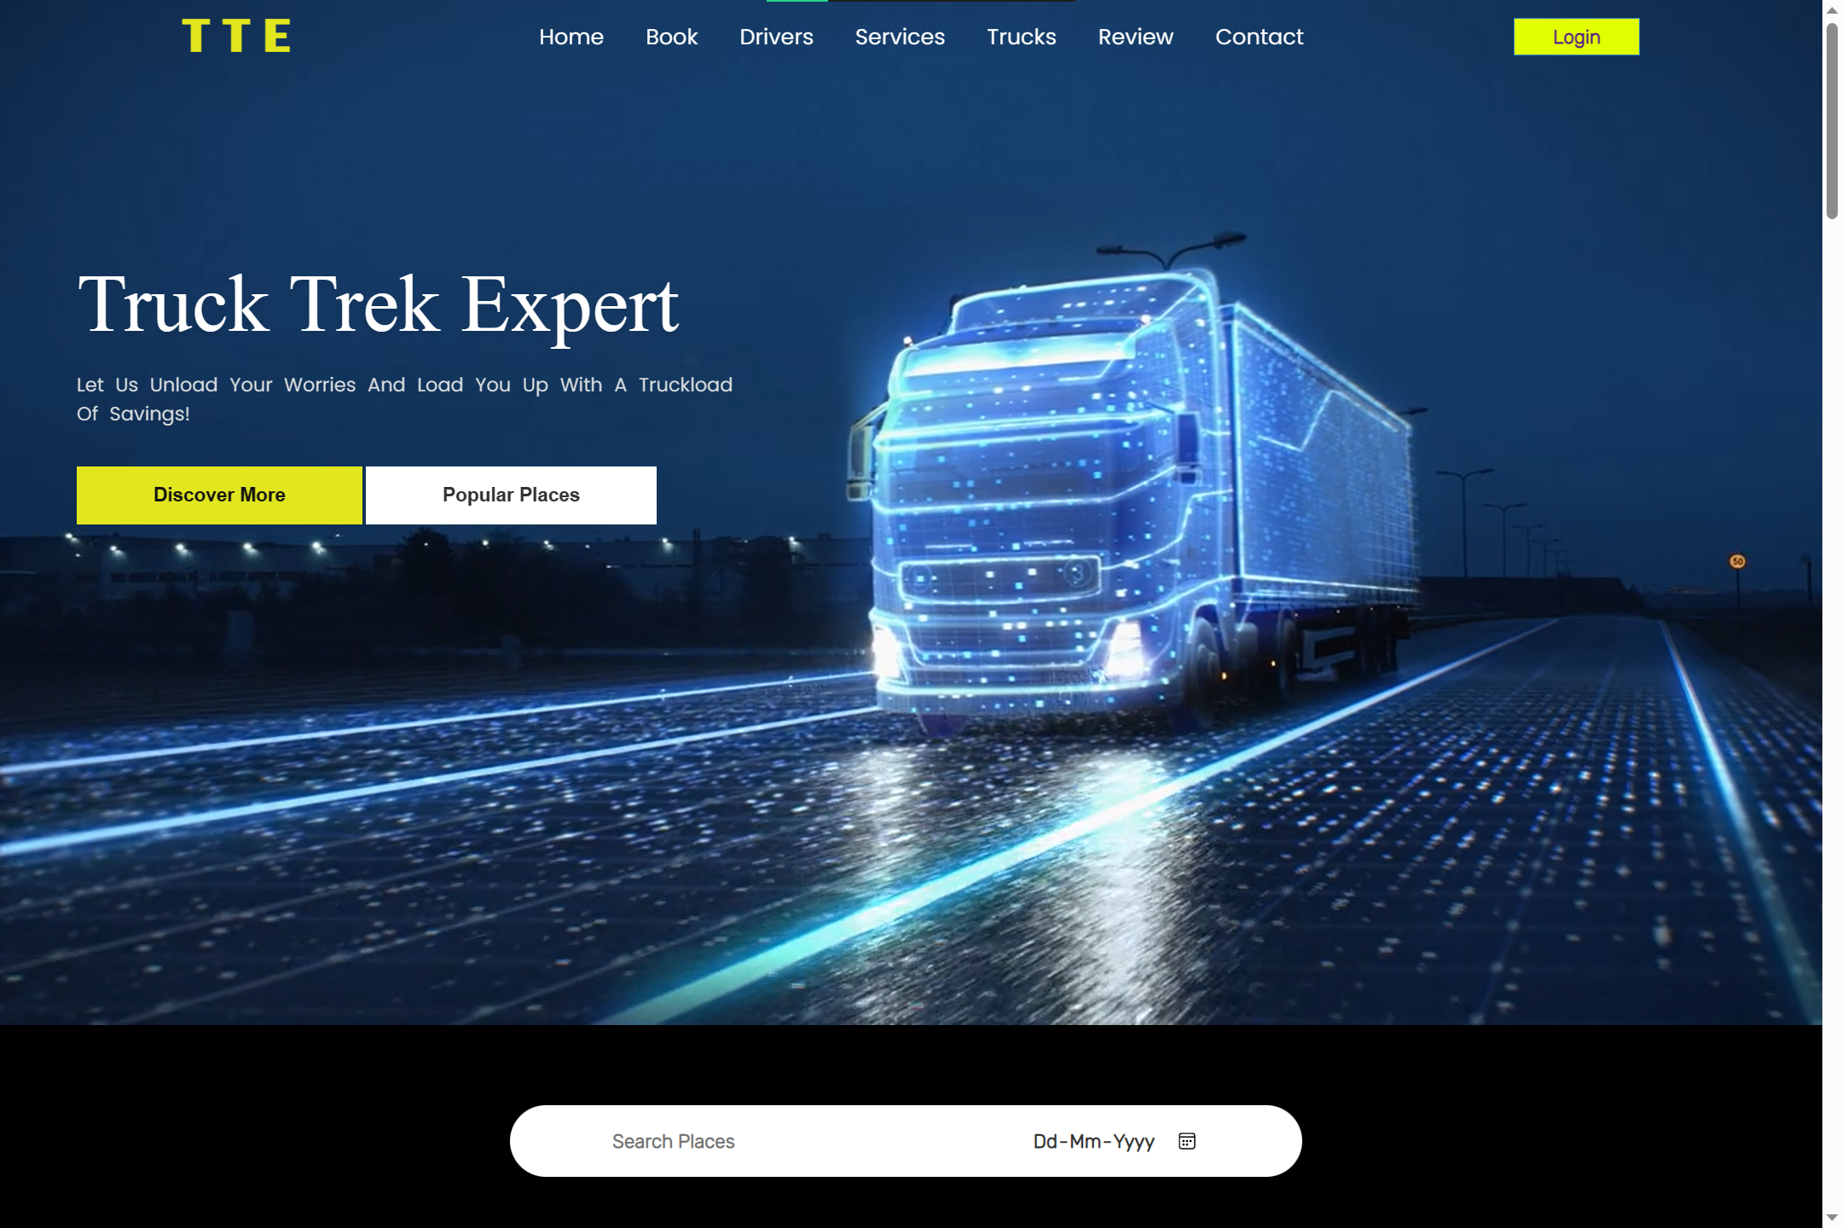

Slide 7
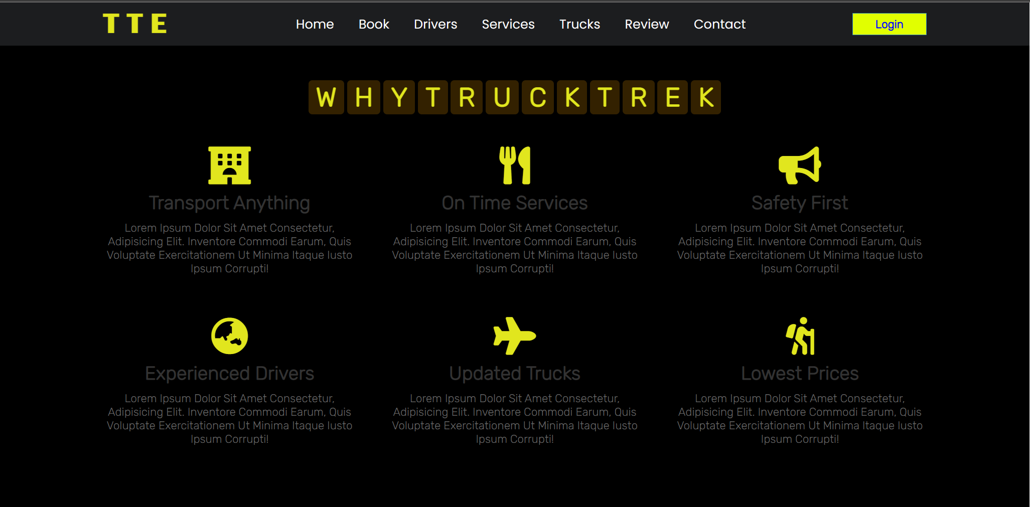

Slide 8
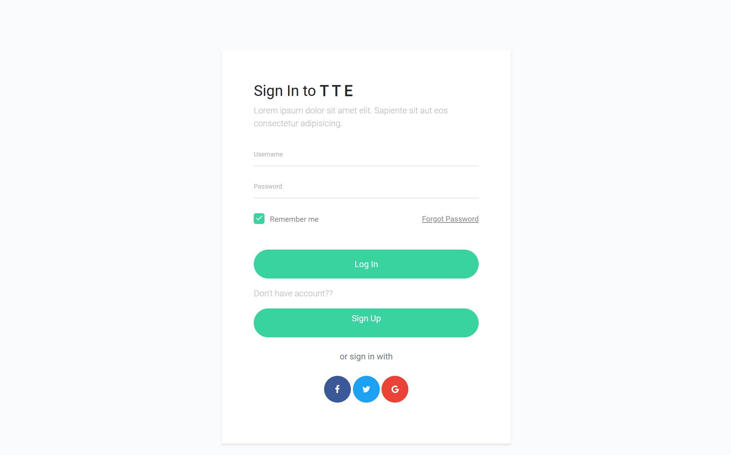

Slide 9
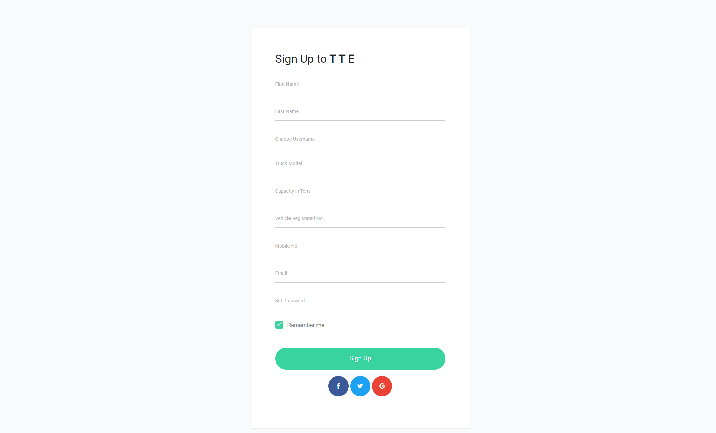

Slide 11
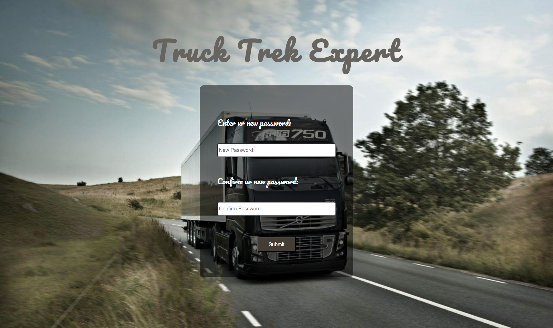

Slide 12
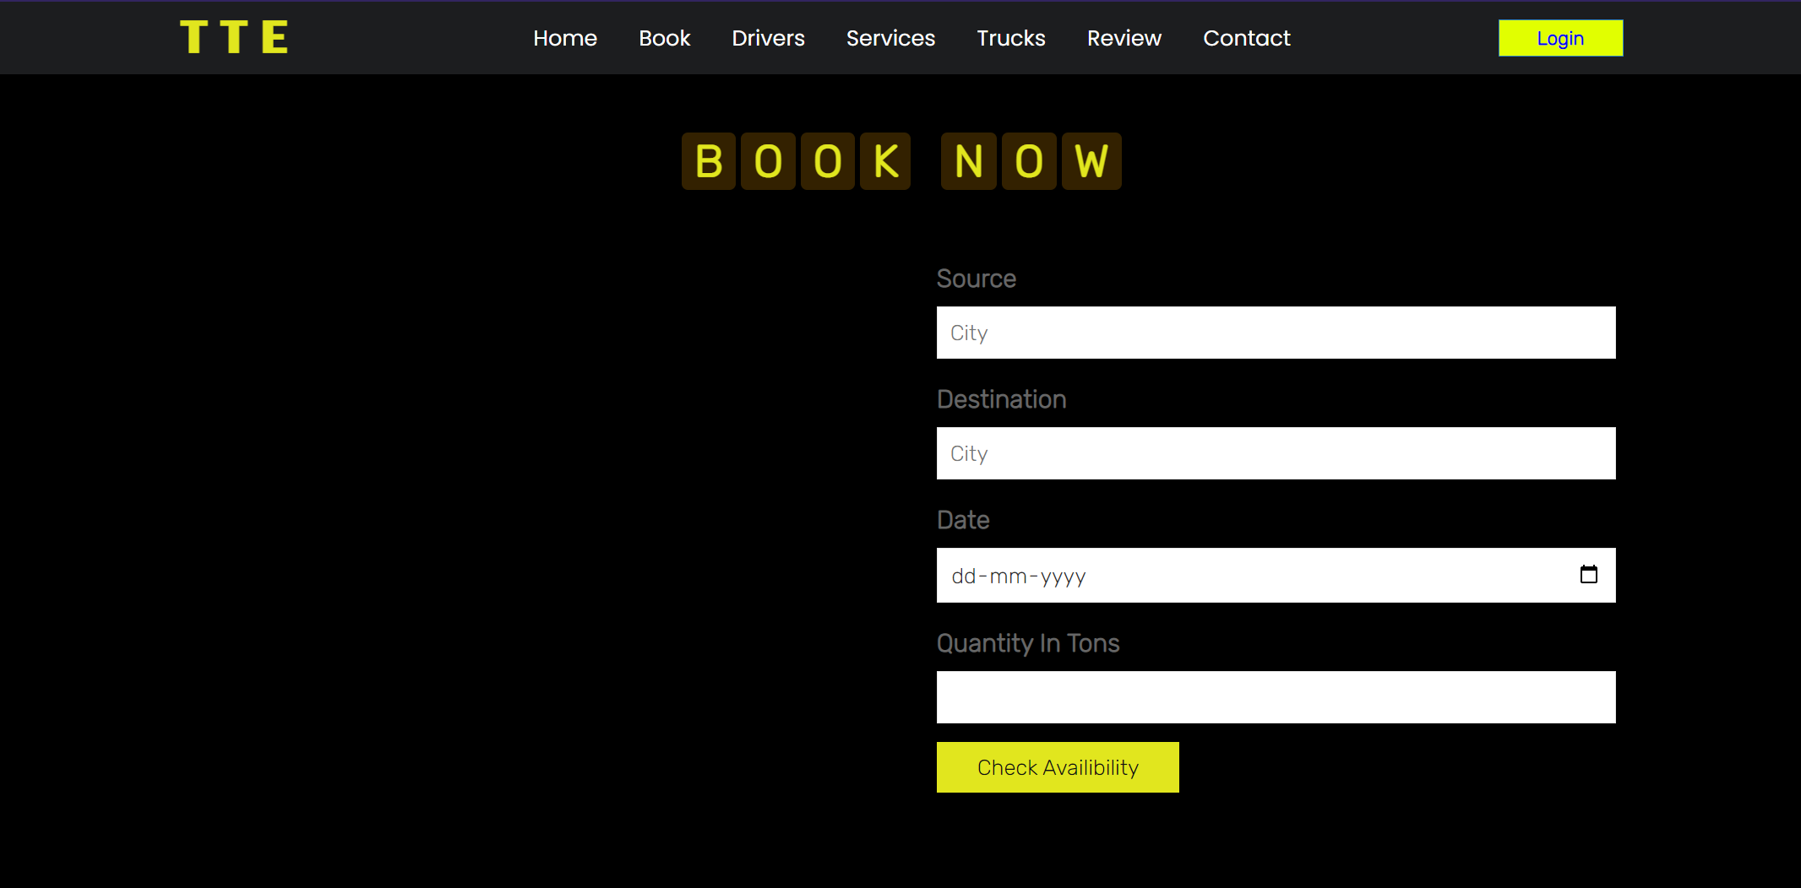
Booking page

Slide 13
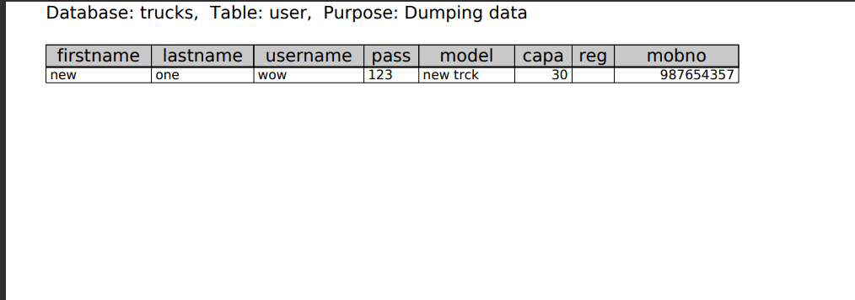
Database

Slide 14
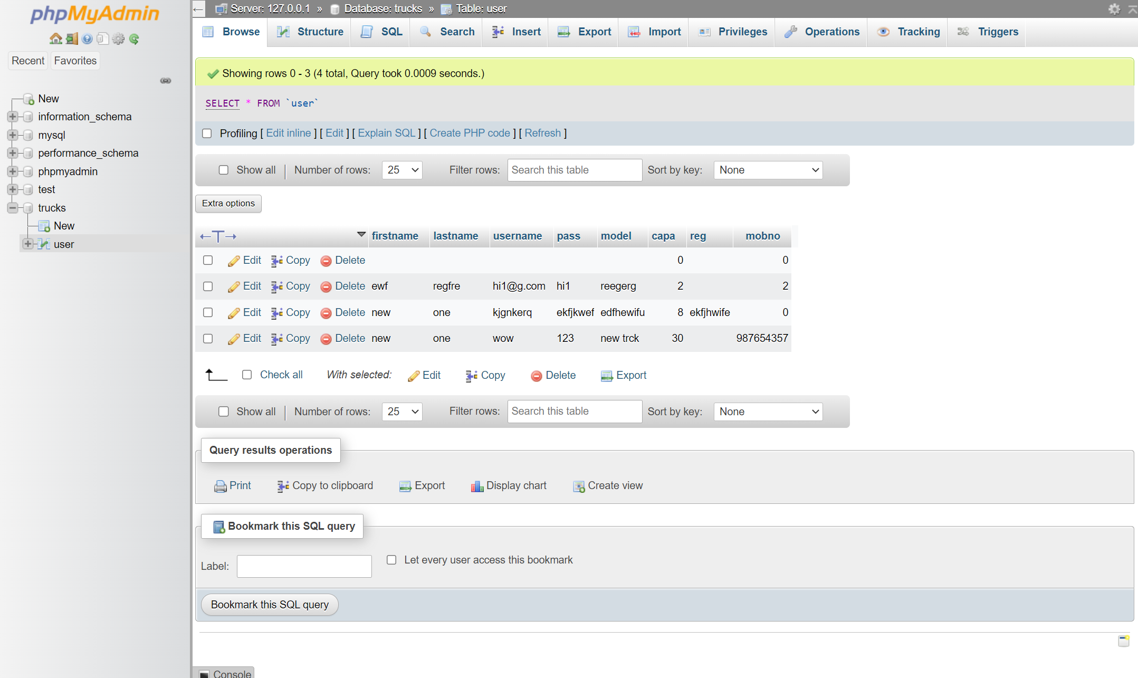
Database

Slide 15

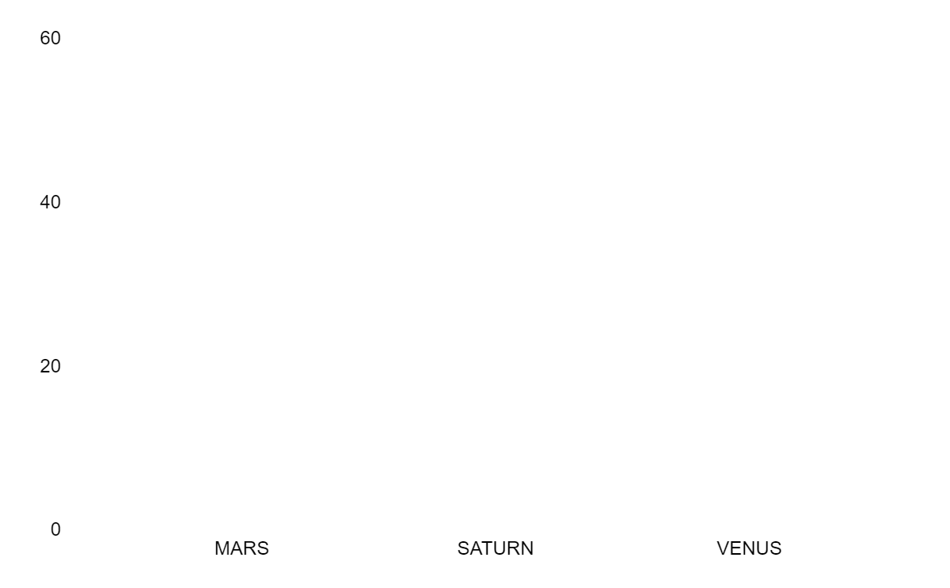
BOOKING TRENDS
60
10
20
March
June
October

Slide 16
2,00,830+
Satisfied customers and still more counting

Slide 17
201
Well updated and maintaned trucks and vehicles

Slide 18
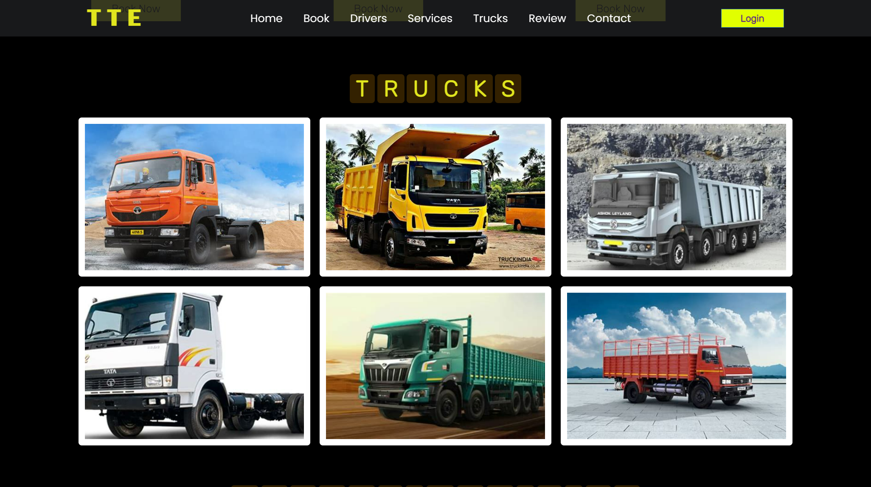
LAPTOP AND DESKTOP SUPPORTED

Slide 19
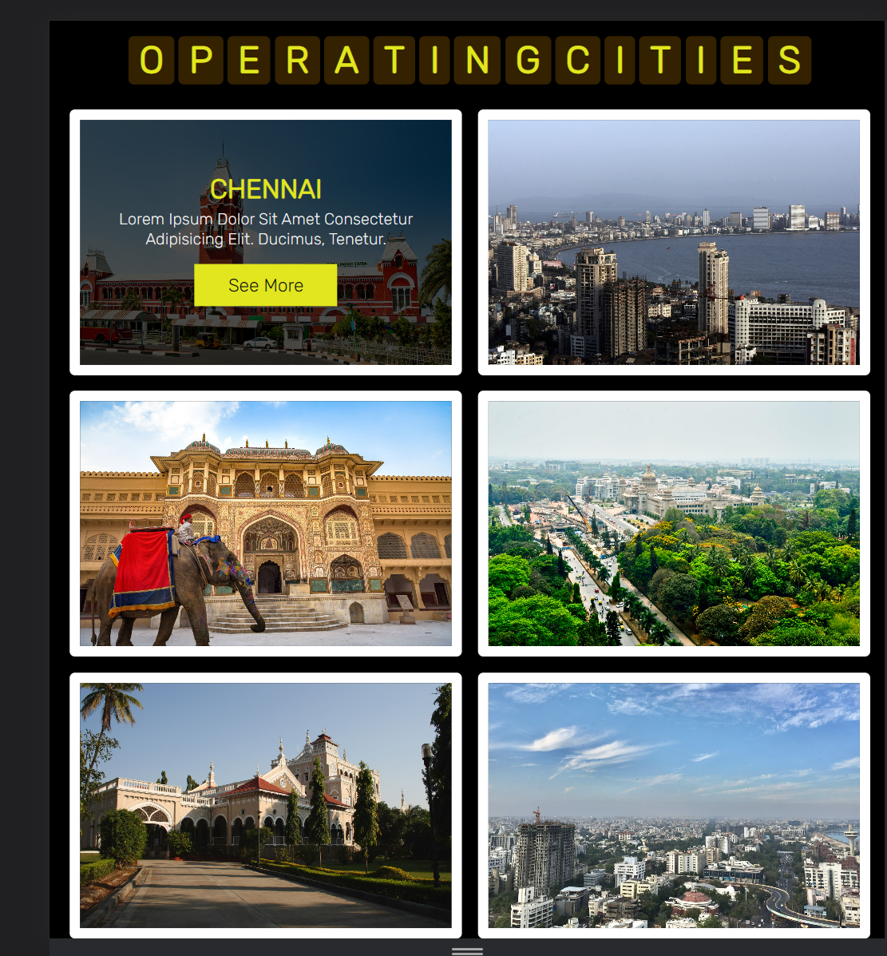
PHONE SUPPORTED

Slide 20

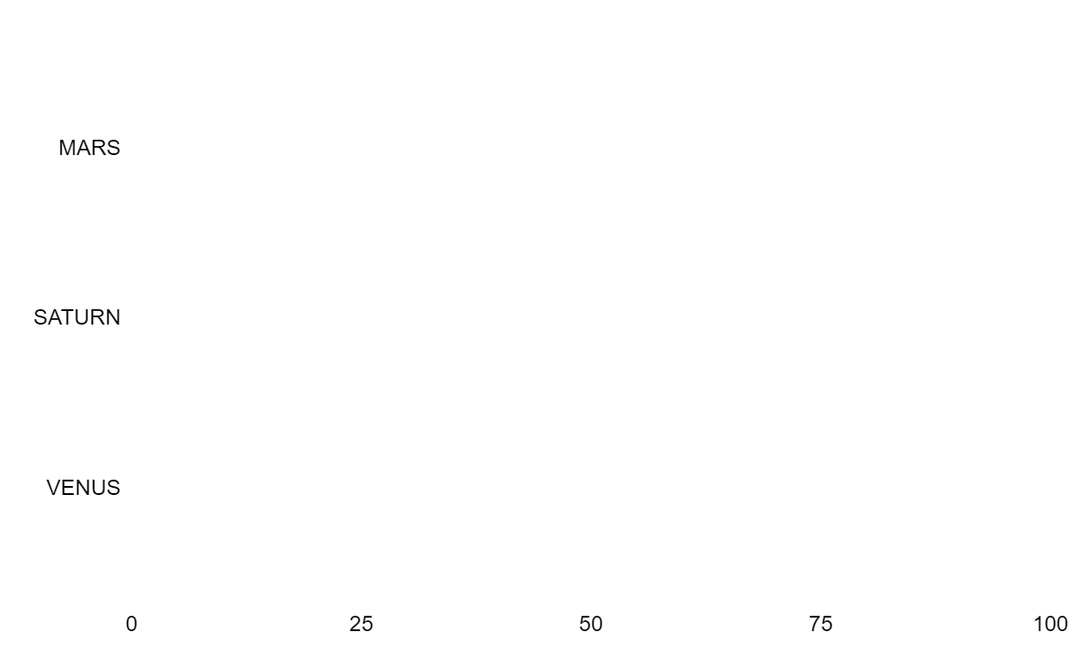
MARKET SHARE
2023
2015
2005

Slide 21

THANK YOU

